Slide 1
California Wildfire Severity
Predictive Analysis & Forecast
MMA 867 Predictive Modelling | Queen's University Smith School of Business
Team Harbour | May 17, 2026
189,550
59
Gradient Boosting
2016–2026
Fire Records (1992–2015)
Counties
Best Model (MAE = 0.418)
Forecast Horizon

Slide 2
Agenda
01
Problem Statement
05
County Risk Ranking
02
Background
06
Model Demonstration
03
Dataset and Seasonal Patterns (1992–2015)
07
Key Insights and Recommendations
04
Forecast 2016–2026
08
Limitations & Next Steps

Slide 3
Problem Statement
Why county-level forecasting matters
Emergency response must be planned without knowing where the worst fires will be.
The US Forest Service (USFS), National Park Service (NPS), and local government agencies face increasing budgetary pressures, as costs have ballooned in recent years.
California alone spends roughly $850,000,000 annually, not accounting for damage and loss.
Wildfires depend on geography, and counties capture both geographical and policy considerations.
For this study, we have limited our analysis to the State of California
Carrying forward statistics such as 'total acres burned' does not tell the whole financial story, so we ask:
?
Which counties will have the most severe fires next season?
$
How should limited budgets be allocated across 59 counties?
Notes:
https://www.statista.com/chart/19807/california-wildfire-emergency-fund-expenditure/
https://oregoncapitalchronicle.com/briefs/oregon-house-passes-bill-to-tax-oral-nicotine-products-direct-funds-to-wildfire-mitigation/

Slide 4
Background
Emergency response is only one element
El Niño Southern Oscillation
(ENSO)
Characteristics of Wildfires
Tactics and Response
Spread speed and heat increase with available fuel
Hot and dry conditions increase fuel
Exponentially more expensive to fight as they grow larger and hotter
Severe fires are defined as greater than 300 acres in size (1.21km²)
Severe fires are fast and unpredictable with large perimeters to defend
Prevention: fuel reduction, firebreaks, protective structures
Detection: lookout towers, satellite, ground sensors
Mitigation: Control lines & burn lines, (done by hand) airborne fire retardant/water drops (very expensive)
Long lead times are required to negotiate contracts, stock warehouses, build structures, and hire employees
ENSO is a monthly measure of Pacific Ocean surface temps to determine the strength of El Niño or La Niña
El Niño means warm and wet weather, La Niña means cold and dry
These conditions affect fuel loading and likelihood of wildfire ignition
Notes:
https://www.weather.gov/mhx/ensowhat

Slide 5
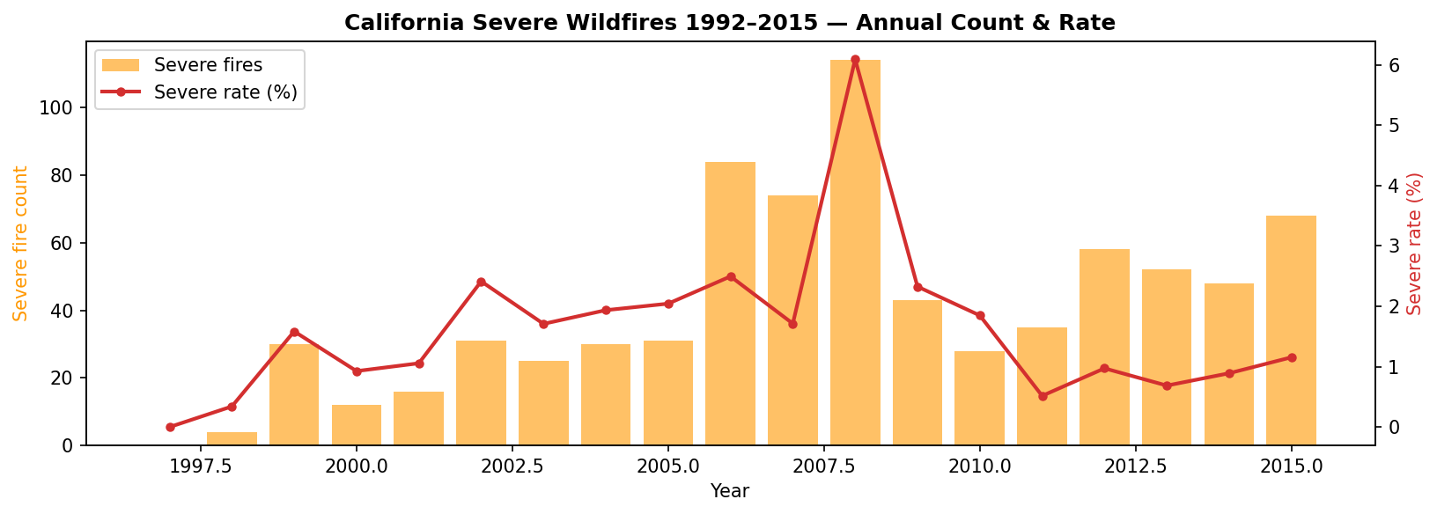
Dataset (1992–2015)
US Forest Service FPA-FOD | California 1992–2015
Most Destructive California Wildfires Since 1932
 | DATE | COUNTY | ACRES | DEAD
1 | Nov 2018 | Butte | 153,336 | 85
2 | Jan 2025 | Los Angeles | 14,021 | 19
3 | Jan 2025 | Los Angeles | 23,707 | 12
4 | Oct 2017 | Napa & Sonoma | 36,807 | 22
5 | Oct 1991 | Alameda | 1,600 | 25
6 | Oct 2003 | San Diego | 273,246 | 15
7 | Aug 2020 | Butte, Plumas, & Yuba | 318,935 | 15
8 | Sep 2015 | Lake, Napa & Sonoma | 76,067 | 4
9 | Oct 2007 | San Diego | 197,990 | 2
10 | Nov 2018 | Ventura | 96,949 | 3
189,550
2,881
Fire Records
Panel Rows
2000s
59
Decade of Peak Frequency (2.3% severe rate)
Counties
6 of 10 Occurred within Past 10 Years
Notes:
Wildfire Data taken from this table: https://34c031f8-c9fd-4018-8c5a-4159cdff6b0d-cdn-endpoint.azureedge.net/-/media/calfire-website/our-impact/fire-statistics/top-20-destructive-ca-wildfires.pdf?rev=737a1073f76947b4a3bfb960b19f44c7&hash=7CA02D30D9BF46A32D5D98BD108BA26A
Accessed from: Cal Fire https://www.fire.ca.gov/our-impact/statistics
Destructiveness was calculated using total cost including damage to property, damage to forests, and loss of life.

Slide 6
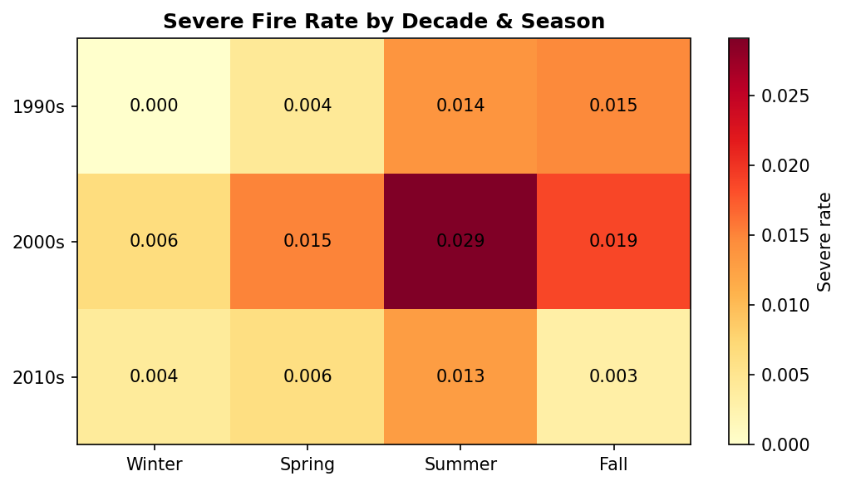
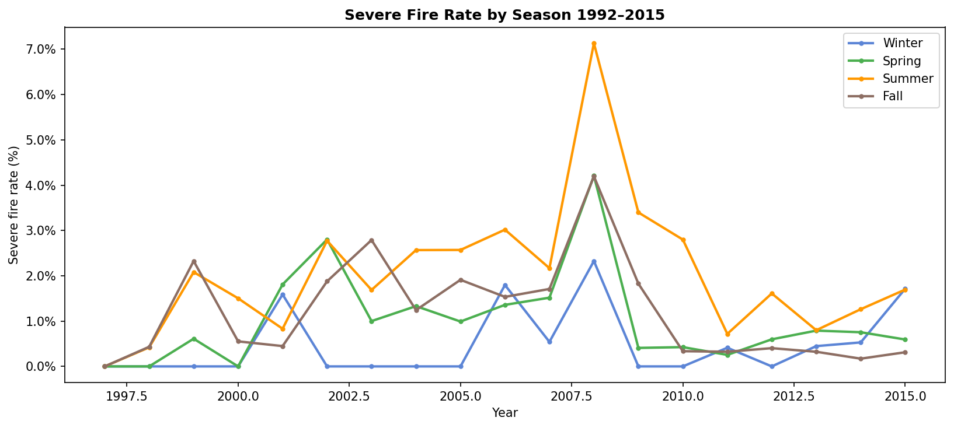
Seasonal Patterns (1992–2015)
Insight: Over the period of study, summer months saw the majority of severe fires (>60%), but spring and fall still contained significant risk. Trends indicate an increasing concentration towards summer fires over time.
Notes:
https://www.fire.ca.gov/our-impact/statistics

Slide 7
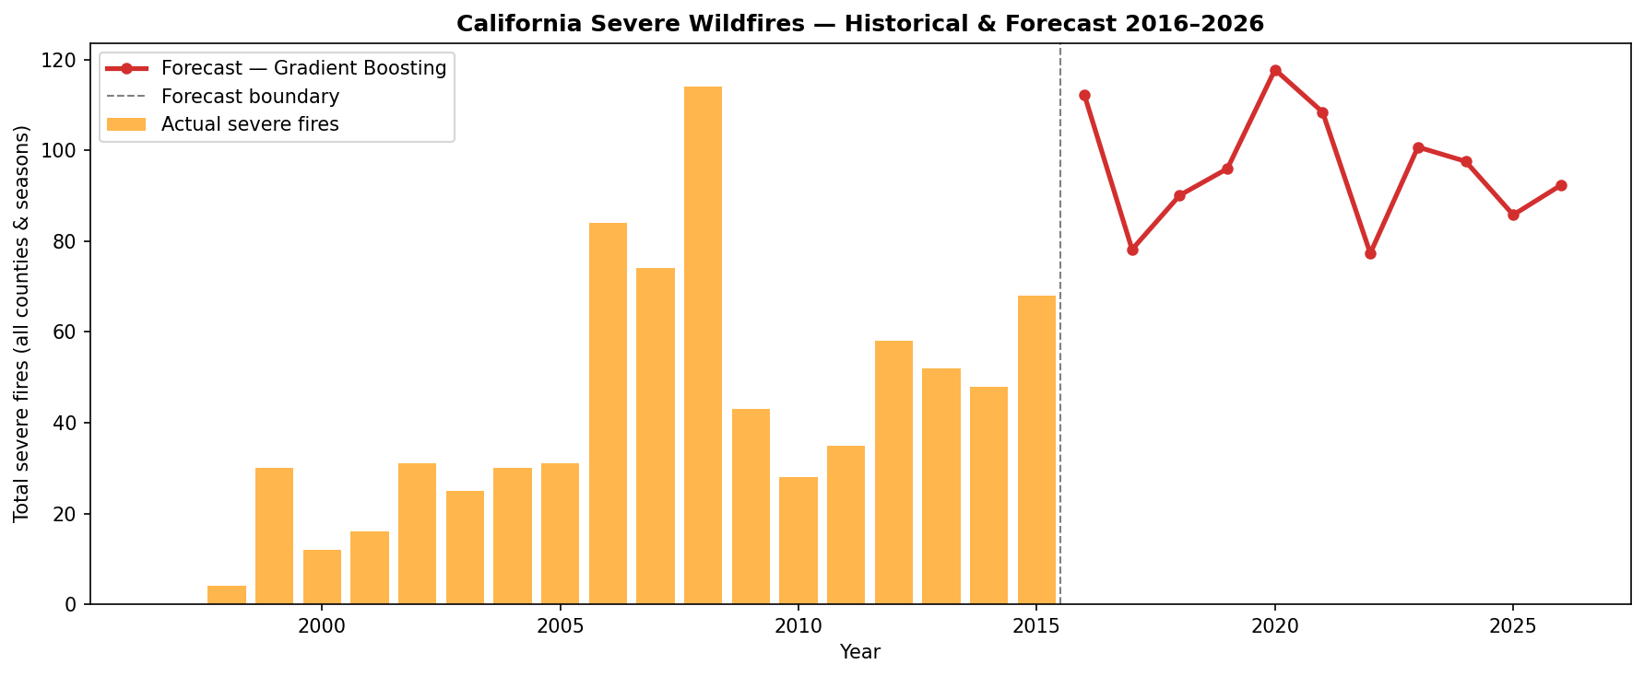
Forecast 2016–2026
Rolling forecast anchored to NOAA ENSO conditions
ENSO-Driven Variation
2016
112 fires
La Niña after 2015 El Niño — fuel dries fast
2017
78 fires
Weak La Niña — below average
2020
118 fires
Moderate La Niña — elevated risk
2022
77 fires
Strong La Niña — suppressed
2023
101 fires
Prediction ends at 2026 because of reliance on published ENSO data
El Niño rebound — vegetation growth

Slide 8
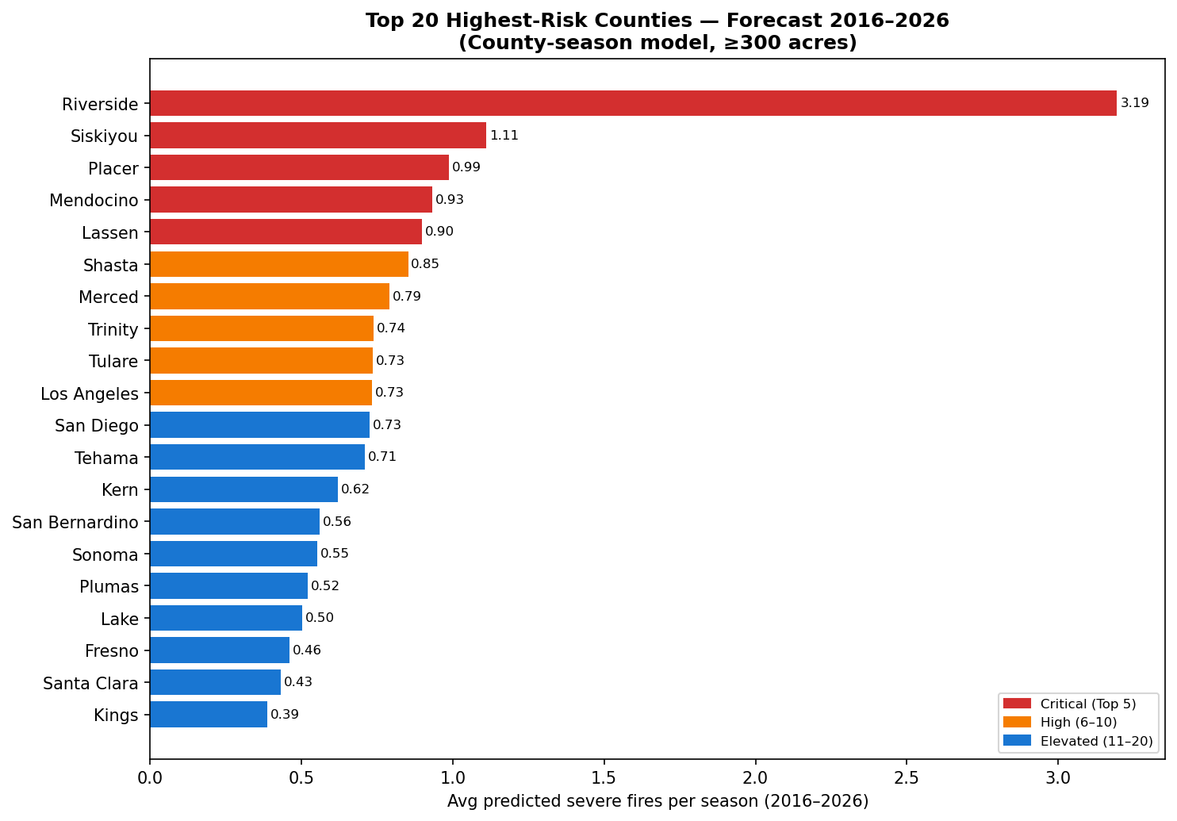
County Risk Ranking (2016–2026)
Average predicted severe fires per season
Top 10 Counties
1
Riverside
3.19/season
2
Siskiyou
1.11/season
3
Placer
0.99/season
4
Mendocino
0.93/season
5
Lassen
0.90/season
6
Shasta
0.85/season
7
Merced
0.79/season
8
Trinity
0.74/season
9
Tulare ✓
0.73/season
10
Los Angeles ✓
0.73/season
✓ = also flagged by Sherry's RF classifier

Slide 9
Key Findings & Recommendations
Most Important Features
Inclusion of Data on El Niño
Lag and Rolling Variables (that capture data from previous 1-3 years) were the strongest predictors of severe wildfires, followed by total wildfires by county.
This indicates that severe wildfire activity is highly autocorrelated over the short term.
Since conditions will likely persist between years, over-preparation is less risky for heavily affected counties.
To mitigate our limited time series, we included data on the ENSO which is published monthly.
This strengthens the model by adding a proxy variable for weather that does not depend on USFS* data.
ENSO data contributes ~15% of explanatory power.
This helps, but an urgent need still exists for current data on wildfires to keep the model robust and useful.
Severity Trends
Counties At Critical Risk of Severe Wildfires
At 2.3%, the 2000s saw highest percent of severe fires.
2010s show fewer but more extreme events, with the largest impacting 315,578 acres (1,277km²)
This trend continues based on USFS reports through 2025.
Recommend a whole-of-government investment in reducing these trends (construction and fuel reduction).
Operational readiness and pre-season mitigation should be prioritized for the following counties:
Riverside
Siskiyou
Placer
Mendocino
Lassen
*USFS - United States Forest Service.
MMA 867 Predictive Modelling | Team Harbour | Queen's University | May 17, 2026

Slide 10
Limitation & Next Steps
Model Limitations
Next Steps
The model does not include drought indicators, *PDSI, *NDVI or detailed local weather conditions.
Estimates for 2016–2026 were based on historical averages and may not reflect current trends.
Geographic approximations of county locations may reduce spatial accuracy.
ENSO conditions for 2026 were assumed to be neutral, which may differ from actual climate patterns.
The model does not predict whether a wildfire will occur.
*PDSI (Palmer Drought Severity Index)
*NDVI (Normalized Difference Vegetation Index)
Add PDSI as a monthly covariate to capture more environmental factors and strengthen the model.
Retrain the model using post-2015 wildfire data to improve accuracy under changing climate conditions.
Incorporating prediction intervals into model outputs using methods such as bootstrap sampling or quantile regression would provide confidence ranges around predictions and improve uncertainty assessment for decision-making.
Developing and deploying an interactive web-based wildfire map and integrating the model with real-time live emergency response data would create a more comprehensive end-to-end wildfire risk management system.

Slide 11
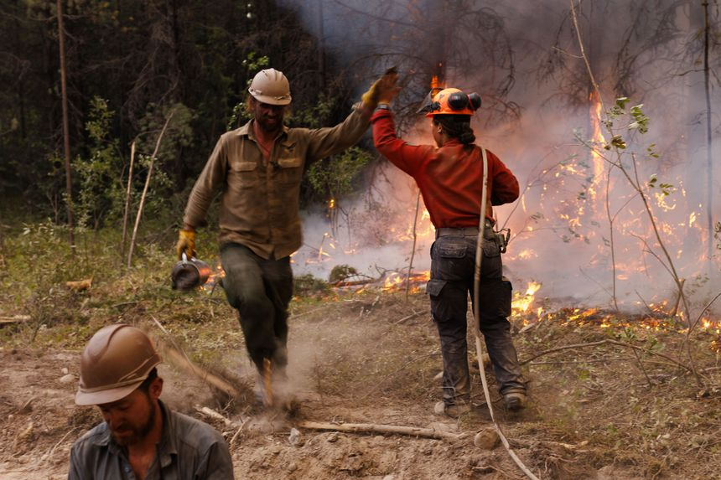
THANKS FOR WATCHING

Slide 12
Methodology
County × Season × Year Panel Forecasting
1992–96 Warm-up
1997–2012 Training (1,784 rows)
2013–15 Validation
2016–2026 Forecast
15 Features engineered:
ENSO Integration
• lag1_severe, lag2_severe — persistent spatial fire regimes
• rolling3_severe — 3-year trend smoothing
• hist_severe_rate — county's intrinsic fire behavior baseline
• enso_score, enso_jja — current-year ENSO climate signal (Jacob)
• enso_score_lag1/2 — fuel-loading lag: wet years → vegetation → fire (1–2 yr delay)
• log_total_fires, FIRE_YEAR, county_enc, season dummies
Key Data Used:
Location
Date and Time of Discovery
County
Acres covered
Additional Data Opportunities:
Time to first response
Time to containment
Time to extinguish
Epicenter proximity to assets
Number of personnel required
El Niño years → above-normal rainfall → dense vegetation growth → fuel load dries & burns 1–2 years later • enso_score: ordinal scale (–2 La Niña → +3 El Niño) • enso_jja: June–July–Aug Niño 3.4 anomaly • 1-yr and 2-yr lags capture the delayed mechanism Data sourced from NOAA/CPC, extended through 2026 — enables genuine forward-looking forecasts anchored to published climate outlooks.

Slide 13
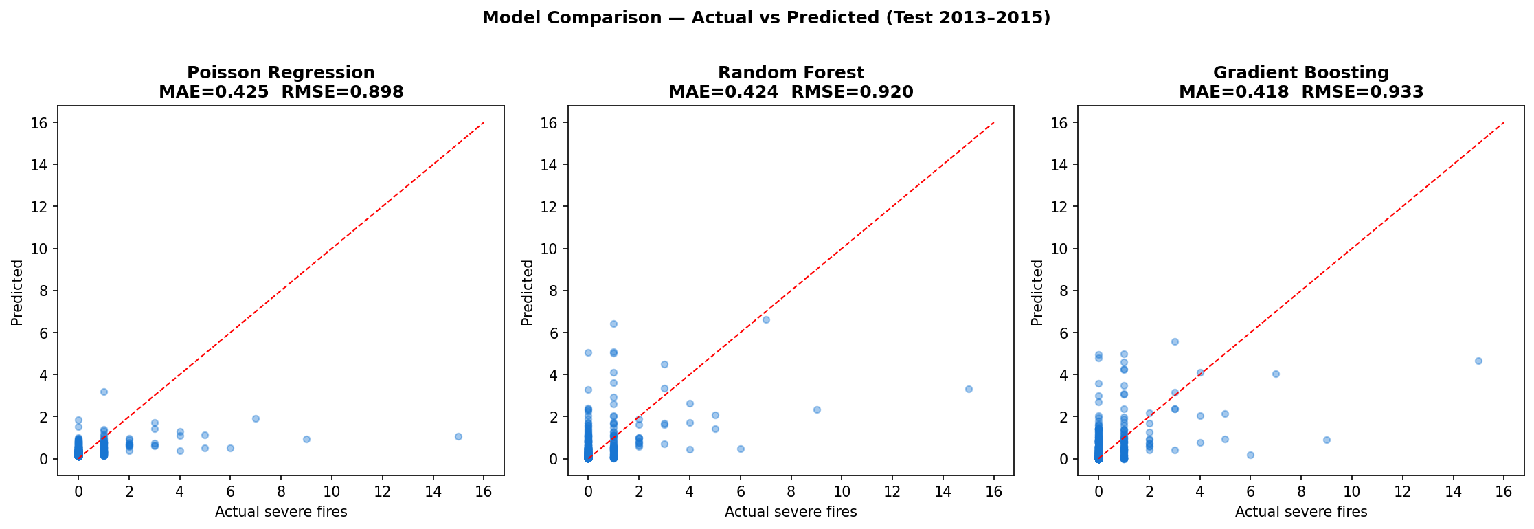
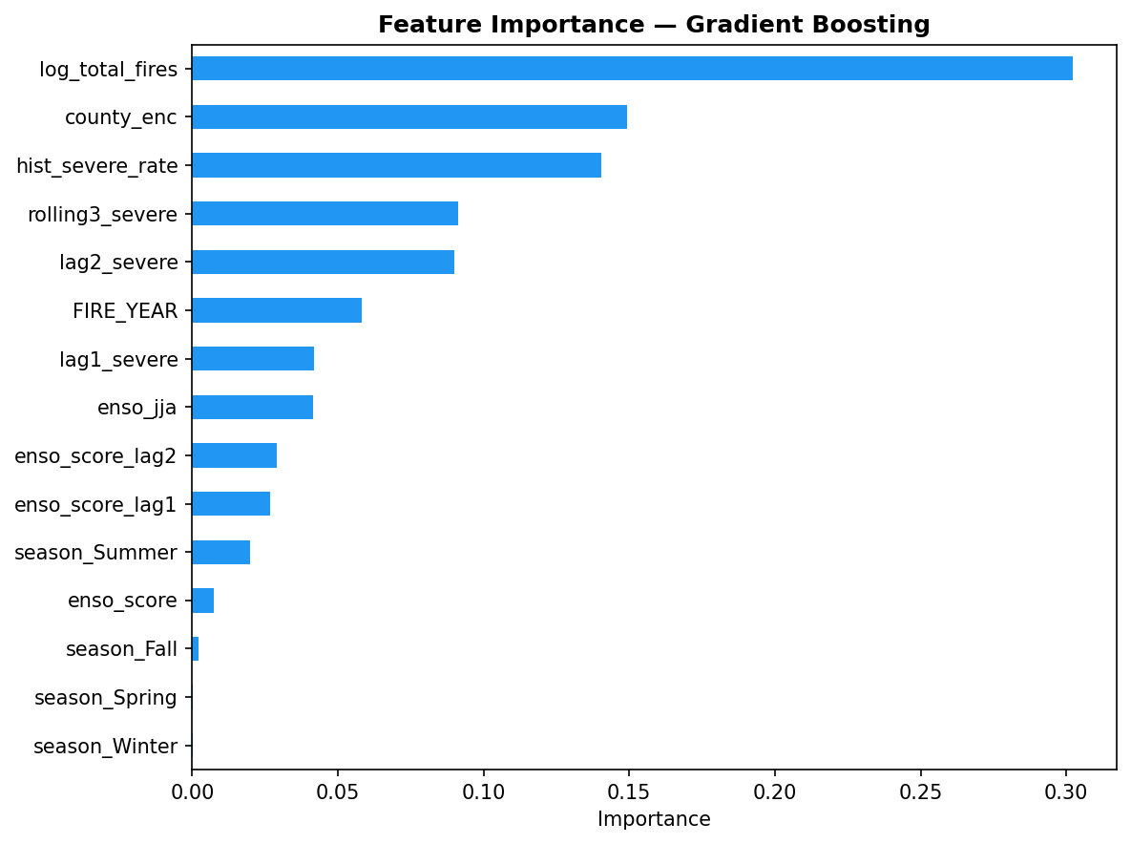
Model Comparison & Results
Train 1997–2012 | Validate 2013–2015
Model Performance
Gradient Boosting ✓
MAE: 0.418 RMSE: 0.933
Random Forest
MAE: 0.424 RMSE: 0.920
Poisson Regression
MAE: 0.425 RMSE: 0.898
Gradient Boosting selected for lowest Mean Absolute Error. The RMSE was particularly high on account of the large outlier of Riverside County in 2015.
Notes:
Poisson Regression taken from the textbook.

